Slide 1
Data Challenge Presentation
Presenter: Wenhan Sun
Notes:
Good morning sirs/ ma’mas
I’m the presenter today and My name is Wenhan Sun

Slide 2
Content
Problem statement
Method & Recommendation
Data preparation & Calculation
Business thoughts (mainly reasons)
Next step
Notes:
First I would like to show you the structure of my pre, help you to better understand and follow up with me
Briefly intro the problem and then walk you through the result I got
After that I will show the details about how I reach out to this result
Why reasons?: also used to support the conclusion
End up with my ideas about improvement

Slide 3

Problem!
Background: A real estate company wants to purchase properties to rent out short-term within New York City
What they know ☺ : two-bedroom properties are the most profitable
Problem ☹ : Do not know which zip codes are the best to invest in
Goal : Find out the most profitable zip codes

Slide 4
Method?
Return on investment (ROI)
* Assumption: The company has no plan to sell the properties
Notes:
ROI not only takes profit into account but also takes cost into account

Slide 5
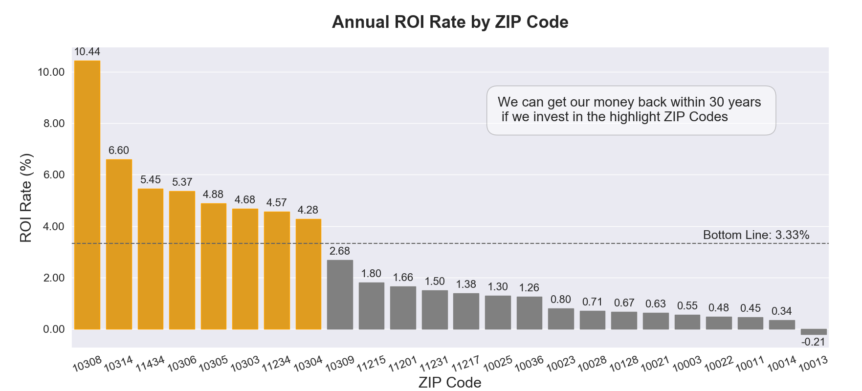
Result!
* Assumption: The company is only interested in zip codes that can have their investment back within 30 years
Notes:
Highlight zip codes are the selected ones.
8 in total
Zip code 10013 is in Manhattan

Slide 6
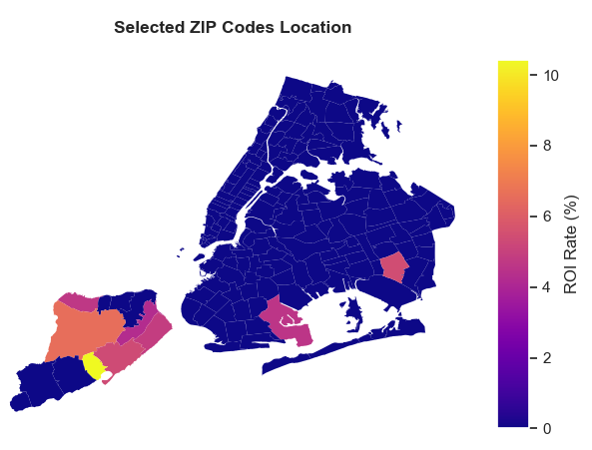
Result!
Staten Island: 6
Brooklyn: 1
Queens: 1
Manhattan: 0
Bronx: 0
Notes:
Things to say at the end:
Next I will talk about
how I manipulate data to get this conclusion
and give some main reasons that why there is no zip code in Manhattan and Bronx

Slide 7
Data preparation

Slide 8
Data Sets
Zillow dataset
zip code level
cost-related information
Airbnb dataset
property level (-> zip code level)
revenue-related information

Slide 9
Data selection
Zillow dataset (81 columns)
zip code, city, state and monthly sales price (2010-01 ~ 2017-06)
Airbnb dataset (12 columns)
zip code, city, state, nightly price, cleaning fee, borough, # of bedrooms, latitude, longitude, is_location_exact, room type and property type
Notes:
After played around with those two data sets, I selected 81 cols from the Zillow dataset and 12 cols form Airbnb set AT LAST

Slide 10
Data clean
Data filtering
2-bedrooms & within NYC
Duplicates
Missing values
KNN imputation
Outliers
Out of three standard deviation
Data type and format
Remove unnecessary characters, categorical <-> numeric
Notes:
If too much missing zip codes?:detect the zip code with lat and lon using a zip code level shape file
Shape file of zip code level: zip code, range of lats & lons for each zip code
Logic: check lat & lon belongs to which range and then assign the zip code to that property
Missing zipcode: 10019

Slide 11
Data munging
Airbnb dataset
Double nightly price for properties renting out bedrooms separately
Convert from property level to zip code level
Zillow dataset
Calculate annual median house price (2010-2017)
Estimate annual median house price (2018-2019): Case Shiller Index
Notes:
Case Shiller index: Home Price Index measures the change in the value of the American housing market

Slide 12
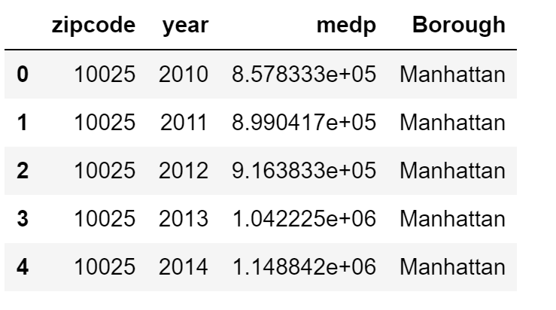
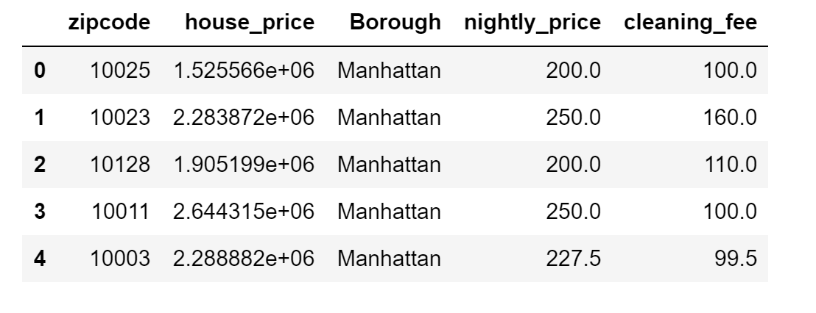
Data munging
Combined datasets
house price trend (2010-2019)
cost, revenue, profit, ROI (2019)
Notes:
Function: pd.merge

Slide 13
Calculation

Slide 14
Assumptions
The company has no plan to sell the properties
The company wants to break even within 30 years
The occupancy rate for each property is 75% all year round
The Airbnb dataset is Airbnb2019
The investor will pay for the property in cash
The time value of money discount rate is 0%
All properties and all square feet within each borough are homogeneous
Notes:
Airbnb2019: be consistent with the Zillow set

Slide 15
Standard formulas
ROI = Profit/ Total Investment *100%
Profit = Revenue – Cost

Slide 16
Revenue (annually)
Assumptions:
The occupancy rate for each property is 75% all year round
The property is occupied for on average 3 days per book
There is no extra guests
Total revenue
- 365*occupancy rate*nightly price
Airbnb service fee
- book_times * service_fee_per_book
- service_fee_per_book = 3%*booking subtotal (the total nightly price plus cleaning fee and additional guest fee)
Net revenue = Total revenue - Airbnb service fee
Notes:
Based on the assumptions and clean data we have
let’s do some calculations …
First let’s calculate revenue

Slide 17
Cost (annually)
* Assumption: property tax rate, insurance, and utilities fee are same for every property
One-time cost = house price + closing cost
- closing cost = 2.5%*house price / 3.5%*house price
[2.5%: house price < $1,000,000; 3.5%: house price >= $1,000,000]
Annual cost = house price*property tax rate+ insurance + utilities

Slide 18
Profit (annually)
profit = net revenue – annual cost
ROI (annually)
ROI = profit / one-time cost * 100%

Slide 19
Data Analysis

Slide 20
Why?
Staten Island: 6
Brooklyn: 1
Queens: 1
Manhattan: 0
Bronx: 0
Notes:
Review the result and find out the reasons

Slide 21
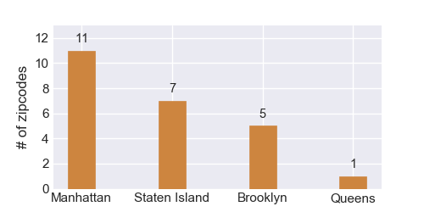
# of zip codes by boroughs
Notes:
Reason why no/few zip codes for Bronx/Queens:
No data for Bronx
Limited data for Queens
Manhattan & Brooklyn? Must be other reasons

Slide 22
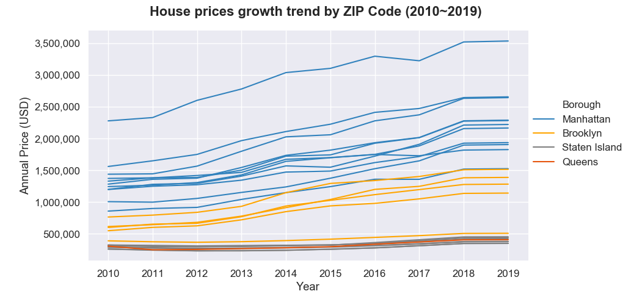
Housing prices by zip code & boroughs
Notes:
Cost of buying a property in Manhattan & Brooklyn is way much high, especially in Manhattan
Which means the profit generates by properties in Manhattan & Brooklyn should also be way much high in order to compensate the high values of cost
So, is the profit high enough?

Slide 23
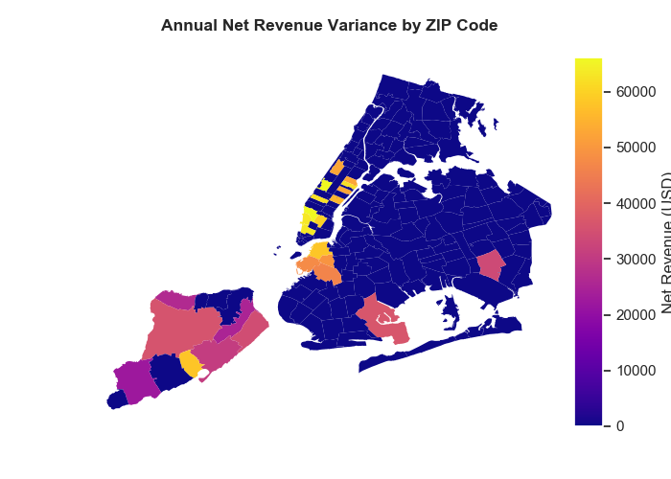
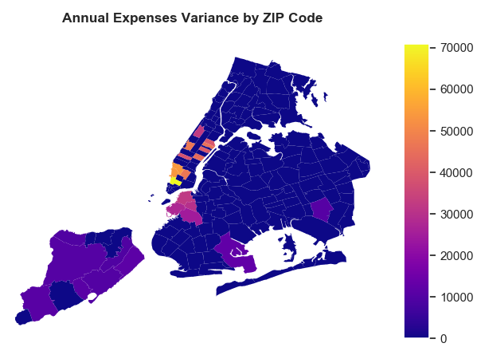

The high annual cost in Manhattan offsets the benefit of high revenue
Net revenue
Annual cost
Profit

Slide 24
Result!
Notes:
Highlight zip codes are the selected ones.
8 in total
Zip code 10013 is in Manhattan

Slide 25
Next Step

Slide 26
How to improve?
Add in more data [# of zip codes: 24 vs 200+]
Get more accurate occupancy rate
Take property appreciation into account
Notes:
Add more data :
only 24 zip codes in total, at least 68 zip codes within nyc
Imbalanced zip codes, majority in staten island and manhattan, balance it
ATTENTION : if we need to take property appreciation into account, then we need to take use of square feet!!!

Slide 27

Data challenge presentation
Thank you

